Slide 1




UNIVERSITY OF BUEA
FACULTY OF ENGINEERING & TECHNOLOGY
2023/2024
CEF440: INTERNET PROGRAMMING AND MOBILE PROGRAMMING
SYSTEM MODELLING AND DESIGN
OF A BIOMETRIC STUDENT ATTENDANCE RECORDING SYSTEM
Task 4
Presented by
Course Instructor
GROUP 12
DR. VALERY NKEMENI

Slide 2

Group 12 Members
NAME | MATRICULE
IHIMBRU ZADOLF ONGUM | FE21A203
CHE KASSINA KUM | FE21A158
NFOUA EUGENE MGBA | FE21A257
FONJI DANIEL KUKUH | FE21A194
EPIE MUKEH SANDRA | FE21A185

Slide 3

Content
INTRODUCTION
CLASSES & ATTRIBUTES
OBJECTIVES
DEPLOYMENT
SYSTEM MODELLING
CONCLUSION
CONTEXT DIAGRAM
ACTORS AND USE CASES

Slide 4

INTRODUCTION
What is System Design?
01
02
03
NOW
•••
Planning
Requirement
Gathering
Requirement
Analysis
System Modelling & Design

Slide 5

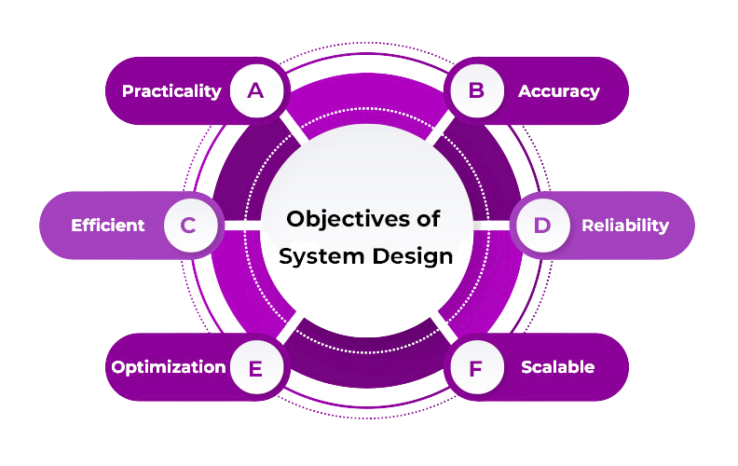
Objectives

Slide 6

SYSTEM MODELLING

Slide 7

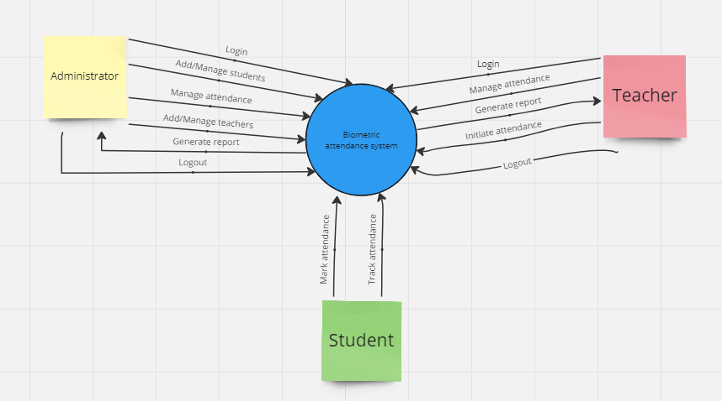
CONTEXT DIAGRAM
Highlights the interaction between users and the system.

Slide 8




Actors
PRIMARY
SECONDARY
TERTIARY
Admin
Email-Messaging Provider
Students
Lecturers

Slide 9
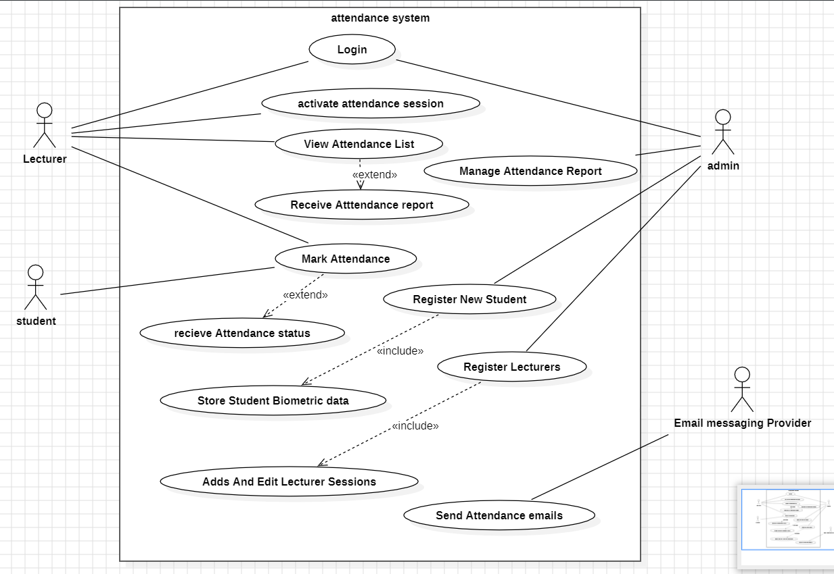
USE CASE DIAGRAM

Slide 10
Understanding the Static Structure

Slide 11
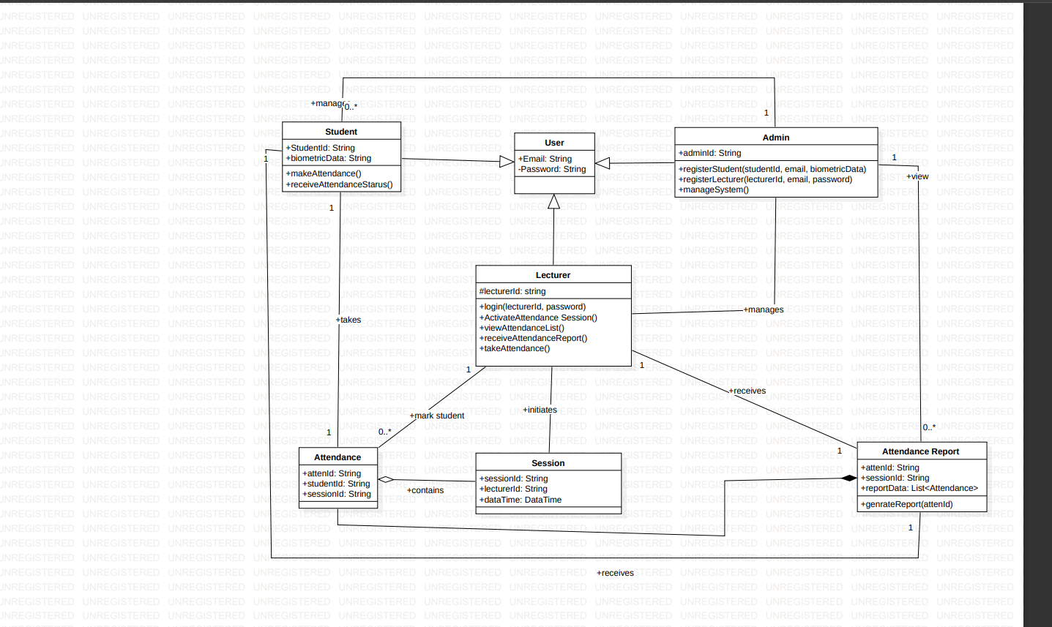
CLASS DIAGRAM
The relationships between these classes illustrate how data is organized and associated within the system.

Slide 12


SEQUENTIAL FLOW
Main Operations
Login Process
Record Attendance
ADMIN
LECTURER
STUDENT AUTHENTICATION
Initiate Attendance
Generate Reports
LECTURER
SYSTEM
LECTURER
STUDENT

Slide 13
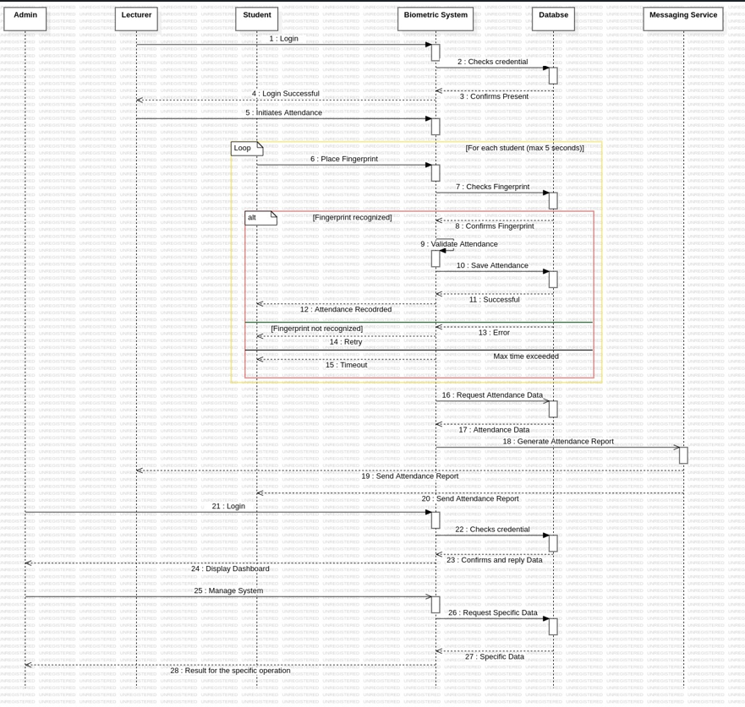
SEQUENCE DIAGRAM
Flow of interactions between various components as a student marks their attendance.

Slide 14




How are the hardware and software components of our system deployed?
COMPONENTS
Database Server
Server
Fingerprint Scanner
Lecturers' Device

Slide 15

Connections & Data Flow
Fingerprint data flow
Attendance recording process
Lecturer access
Configuration management

Slide 16
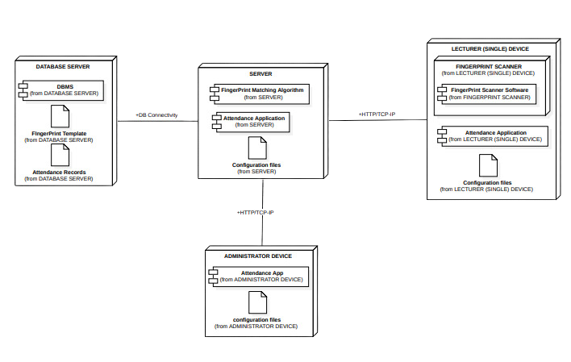
DEPLOYMENT DIAGRAM

Slide 17
CONCLUSION
Thank you for keen attention!

